Slide 1
Emblem Detection For Commercial Research

Slide 2
Objectives
Finding a good learning rate
Data preprocessing
Augmentation
Baseline model.

Slide 3
Presentation Outline
1. Introduction
2.Data Source
3.Methodology
4.Evaluation/Results
5.Summary

Slide 4
Introduction
Our project recognizes the brand emblem present in any image.
The image emblem classification is built using two different models of neural network.
The main concept of image classification using CNN consisting three layers.
One model consists of Keras with tensorflow backend and the other is implementing using Google’s Inception v3 model.
At last ,our project is deployed in EC2 instance to create web application with user interface.

Slide 5
Why we chose CNN
1. Ruggedness to shifts and distortion in the image.
2.Reduced memory requirement
3.Easier and better training.

Slide 6
Data source
The dataset we used here is an annotated logo dataset downloaded from Flickr. It involves three image sets:
The training set contains 810 annotated images, corresponding 27 logo classes (30 images for each class).
.The test set consists of 270 images, of which 135 are for each of the 27 annotated classes
The brands included in the dataset are: Adidas, Apple, BMW, Citroen, Coca Cola, DHL, Fedex, Ferrari, Ford, Google, Heineken, HP, McDonalds, Mini, Nbc, Nike, Pepsi, Porsche, Puma, Red Bull, Sprite, Starbucks, Intel, Texaco, Unisef, Vodafone and Yahoo.

Slide 7

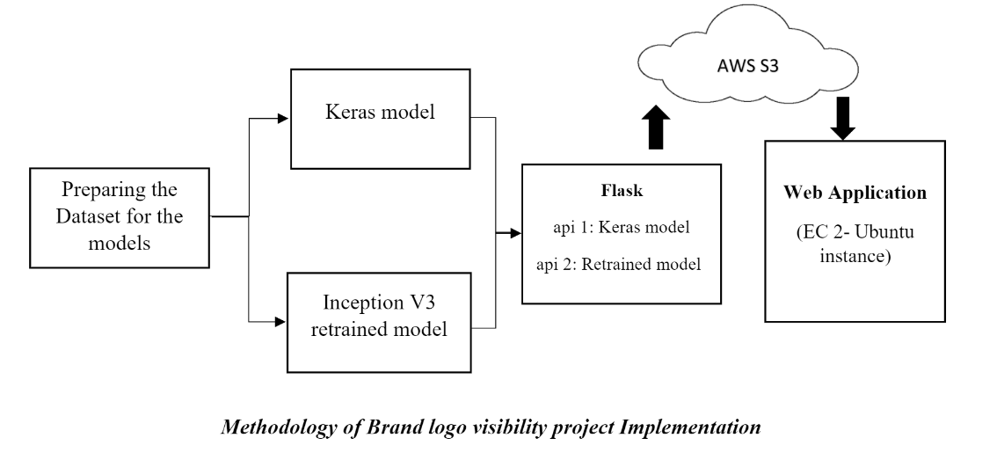
Methodology

Slide 8
Approach
Images and features extracted from data
Build predictive model using CNN technique
Images identified through testing and evaluation
Analysis on based of results

Slide 9
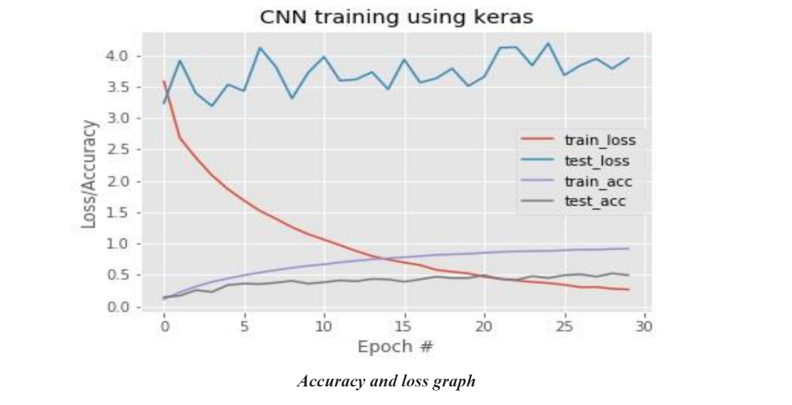
Results

Slide 10
Summary and Evaluation
Planning to add pipeline and docker.
In the future, we can improve our model by applying more features meticulously and tuning the parameters more precisely.

